Slide 1
Fashion Product Analysis
Using AI

Slide 2
LLaMA – 3B

Slide 3
Amazon Fashion Reviews
Fashion Product Feedback Dataset (OpenDataBay 2025)
H&M product descriptions (Kaggle)
QLoRA
QLoRA
QLoRA
LLaMA – 3B

Slide 4
Amazon Fashion Reviews
Fashion Product Feedback Dataset (OpenDataBay 2025)
H&M product descriptions (Kaggle)
QLoRA
QLoRA
QLoRA
LLaMA – 3B

Slide 5
Keyword
Google Shopping API
Find Similar kind of Product
Extract Brand, Price, Rating, Review
Structure Output Using Gemini API

Slide 6
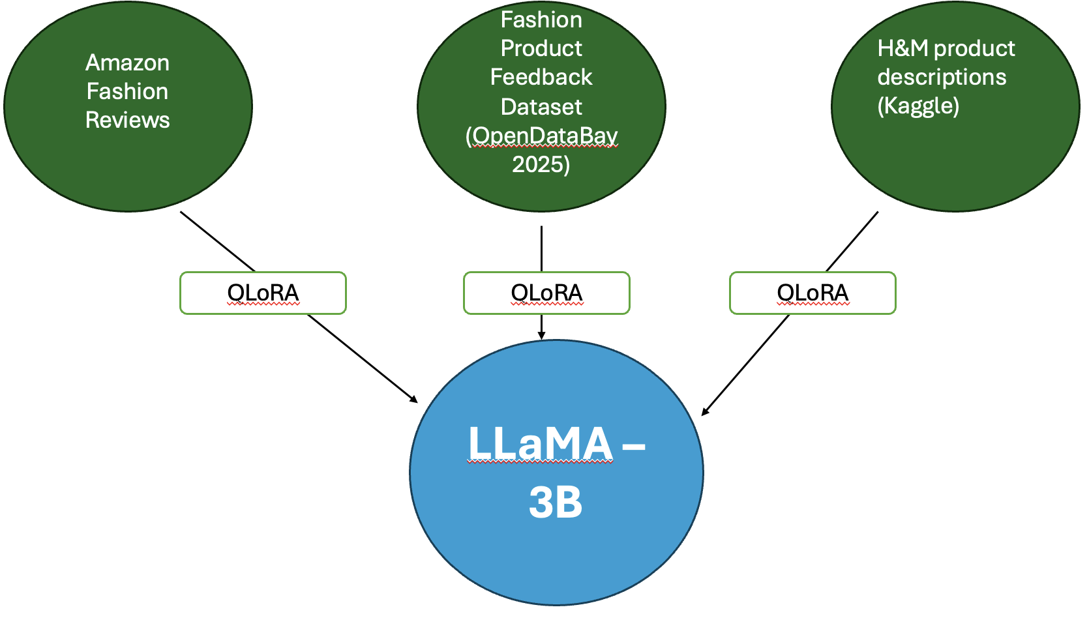
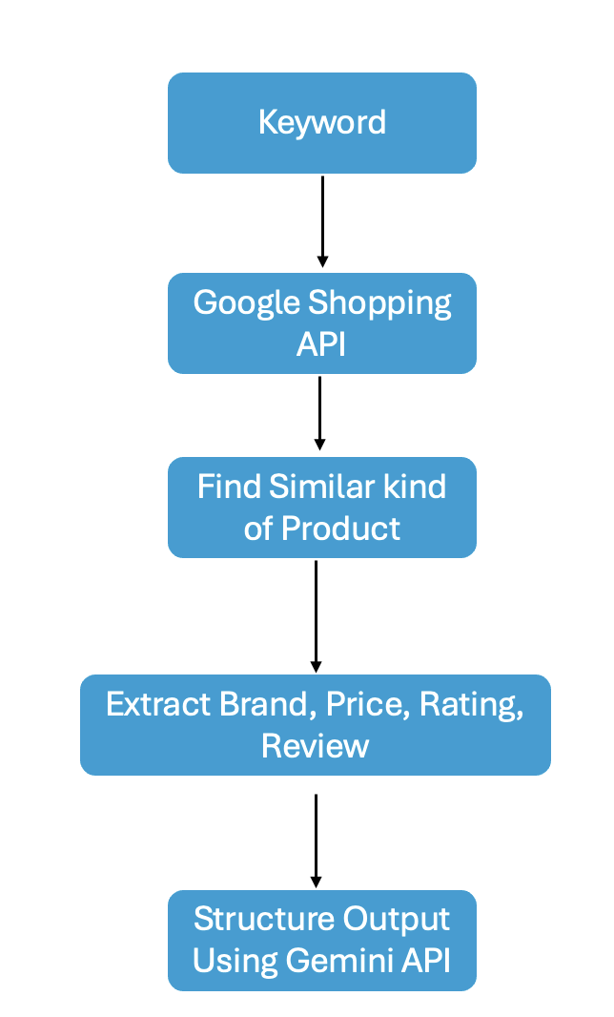
Product Name
Product Type
Price Range
Input
Description
Extract Keyword Using Gemini API

Slide 7
Fine-tuned Model
AI Agent
Output
Analysis by Gemini Using Structure Input
Brand, Price
Sentiment Analysis Of Rating And Review
Generate Detail Suggestions
Negative (-1)
Neutral (0)
Positive (+1)

